Slide 1
Assignment 1: Automatic Lense Smear Detection
CS 513 - Brianna Bransfield and Christopher Morcom

Slide 2
Assignment Goal
Input: Given sequence of consecutive street view images - For cameras at varying angles on probe
Output: Mask of the smear on the lens

Slide 3
Approach
Used OpenCV python for the code
To calculate the smear, we assumed the most common feature between the images was any attenuation or issues with lense of camera (smear)
Grey scaled all images to normalize for our application - Smear isn’t color based
Notes:
To calculate the smear our logic is that the most common feature between all images is any attenuation or issues with lense of camera (smear). If we take average image we should be left with mask of smear. We had the grey scale the images to normalize them for our applciaiton since smear isn't color based.To get that we divided every pixel of every image by the # of images per camera and added it to a common new mean image.

Slide 4
Approach Continued ...
4. Divided every pixel of every image by the number of images per camera and added it to a common new mean image
5. When manually scanning through images smear is easier to detect when noise is significantly high since it gives image uniform background

Slide 5
Problems Along the Way
Mean image makes it easier to see smear, but harder for the computer to process - due to gradience and noise
When processing the noise we ran into issues where this could have been mistaken for smear
Seen in binary image mask since it covers areas the smear does not and vice versa
Notes:
The mean image makes it easier to see smear but harder for the computer to process since mean image has gradience throughout it and noise. When we were trying to process the noise we ran into issues (cam 0) that feature could have been mistaken for smear. Can be seen in binary image mask since it covers areas that the smear doesnt cover and vice versa

Slide 6
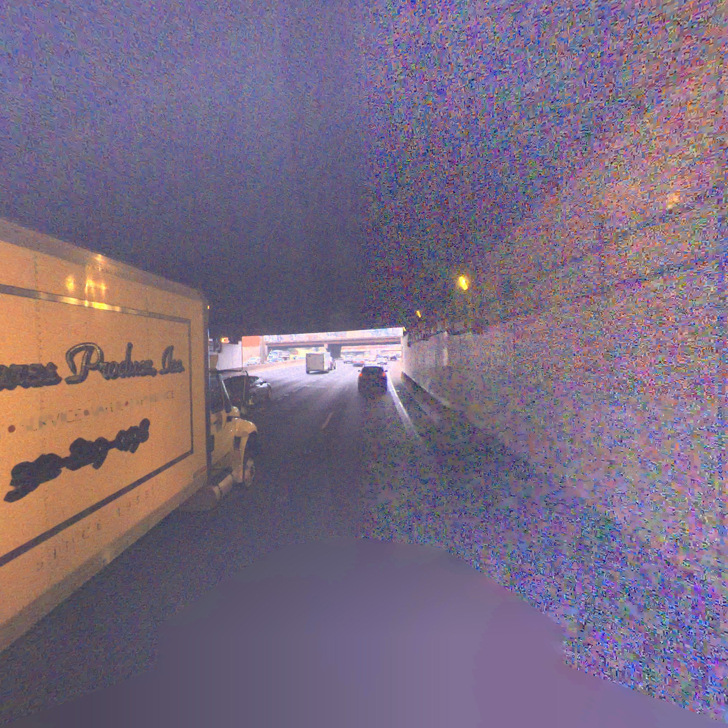
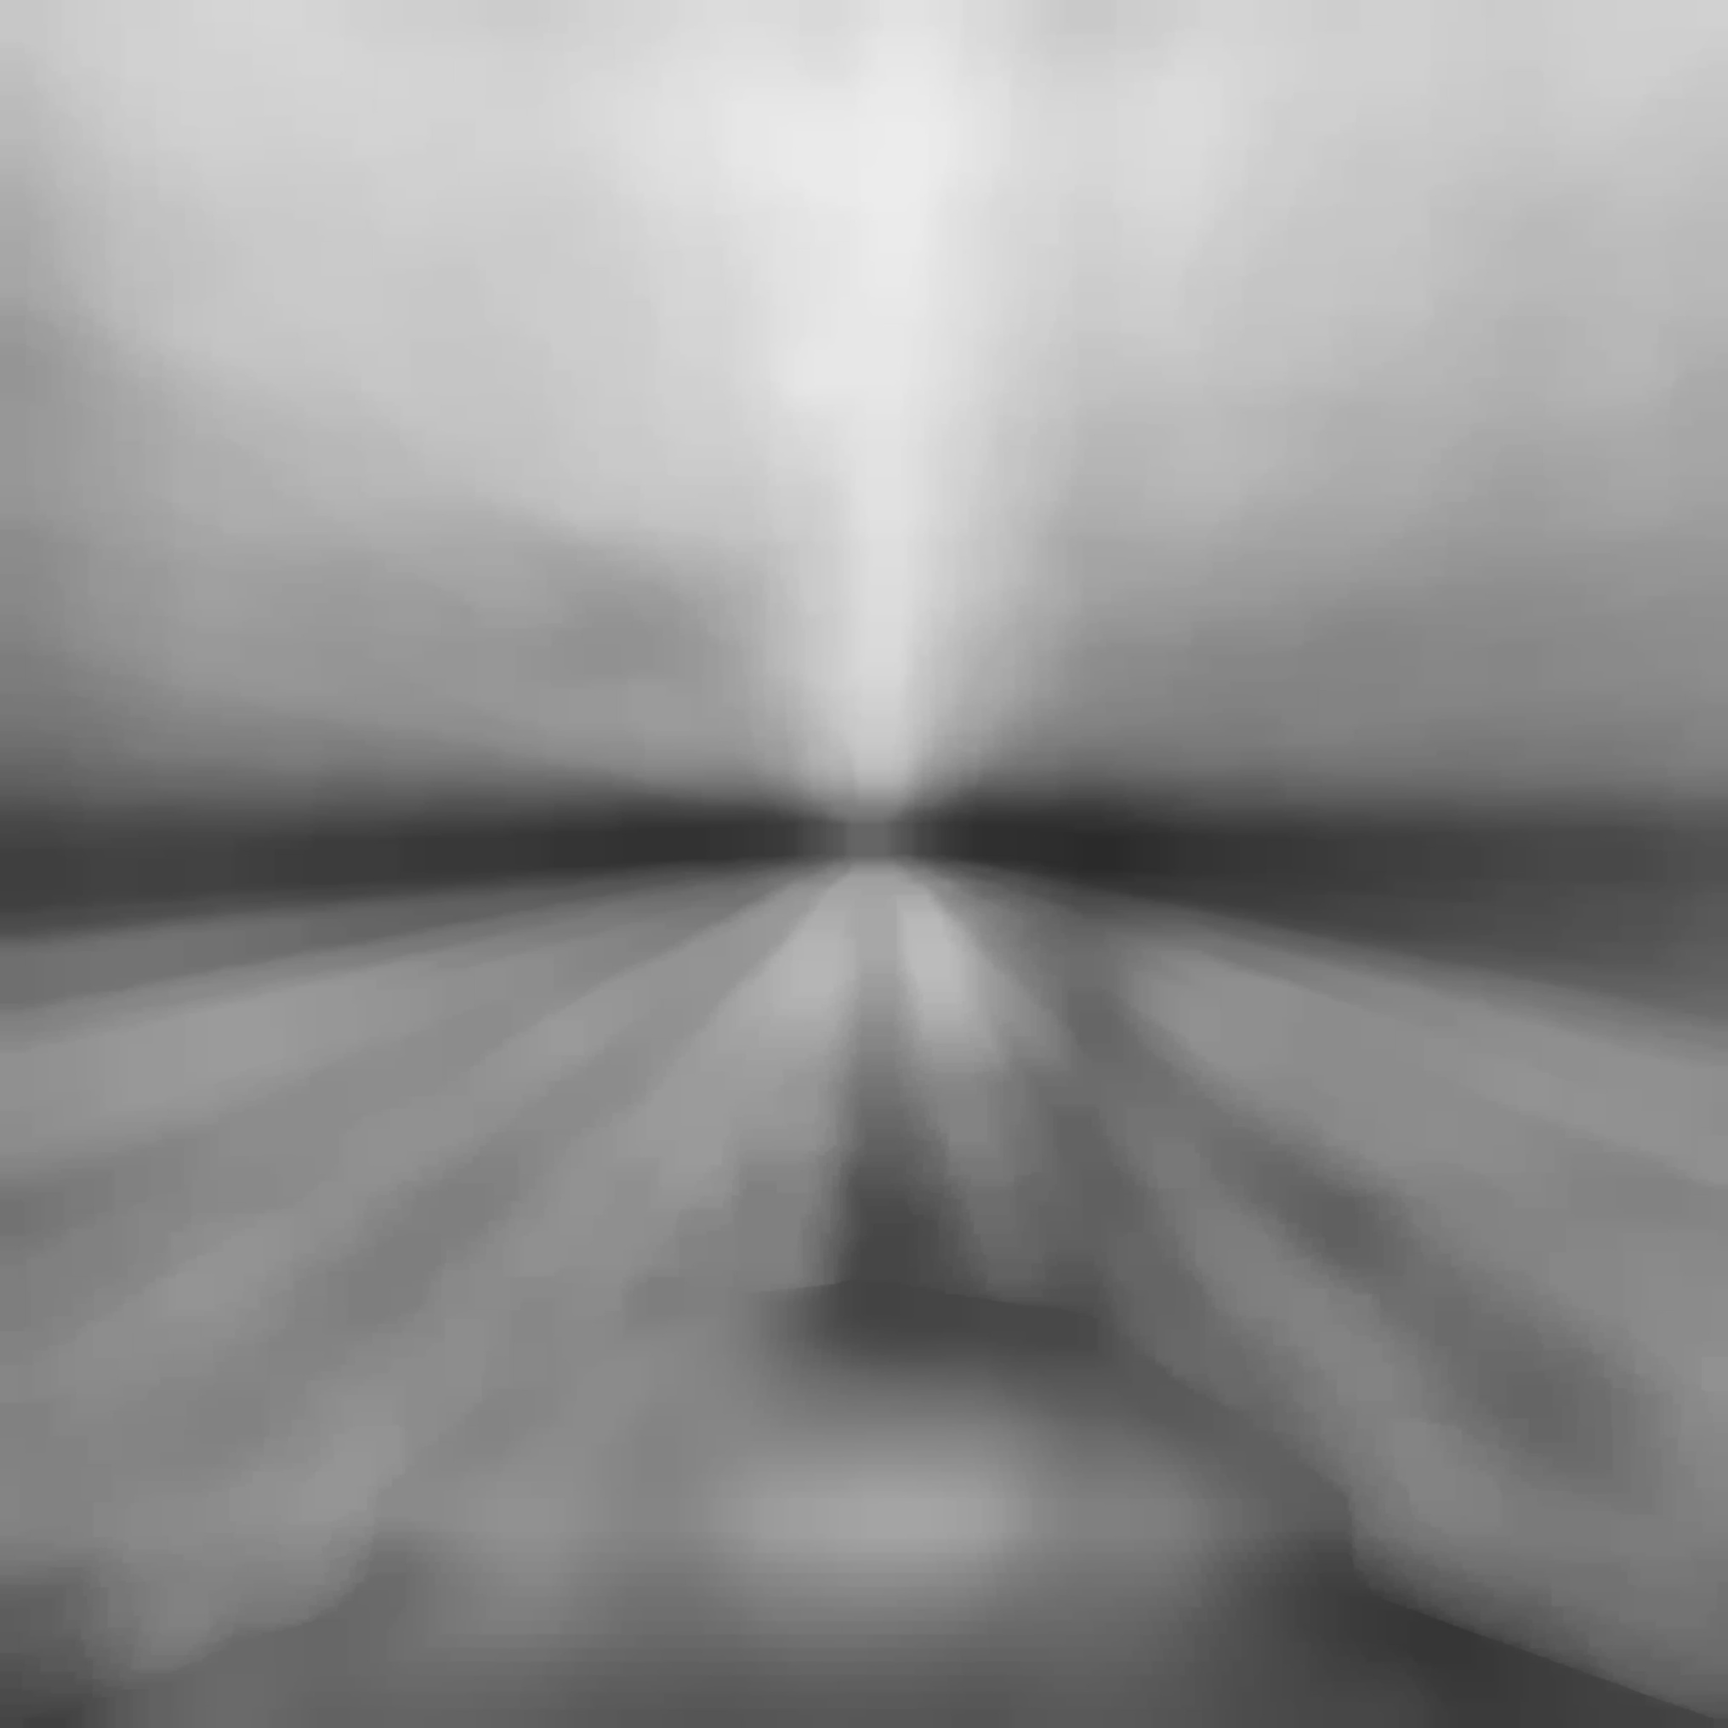
Camera 0 Images - Noise Interference

Slide 7
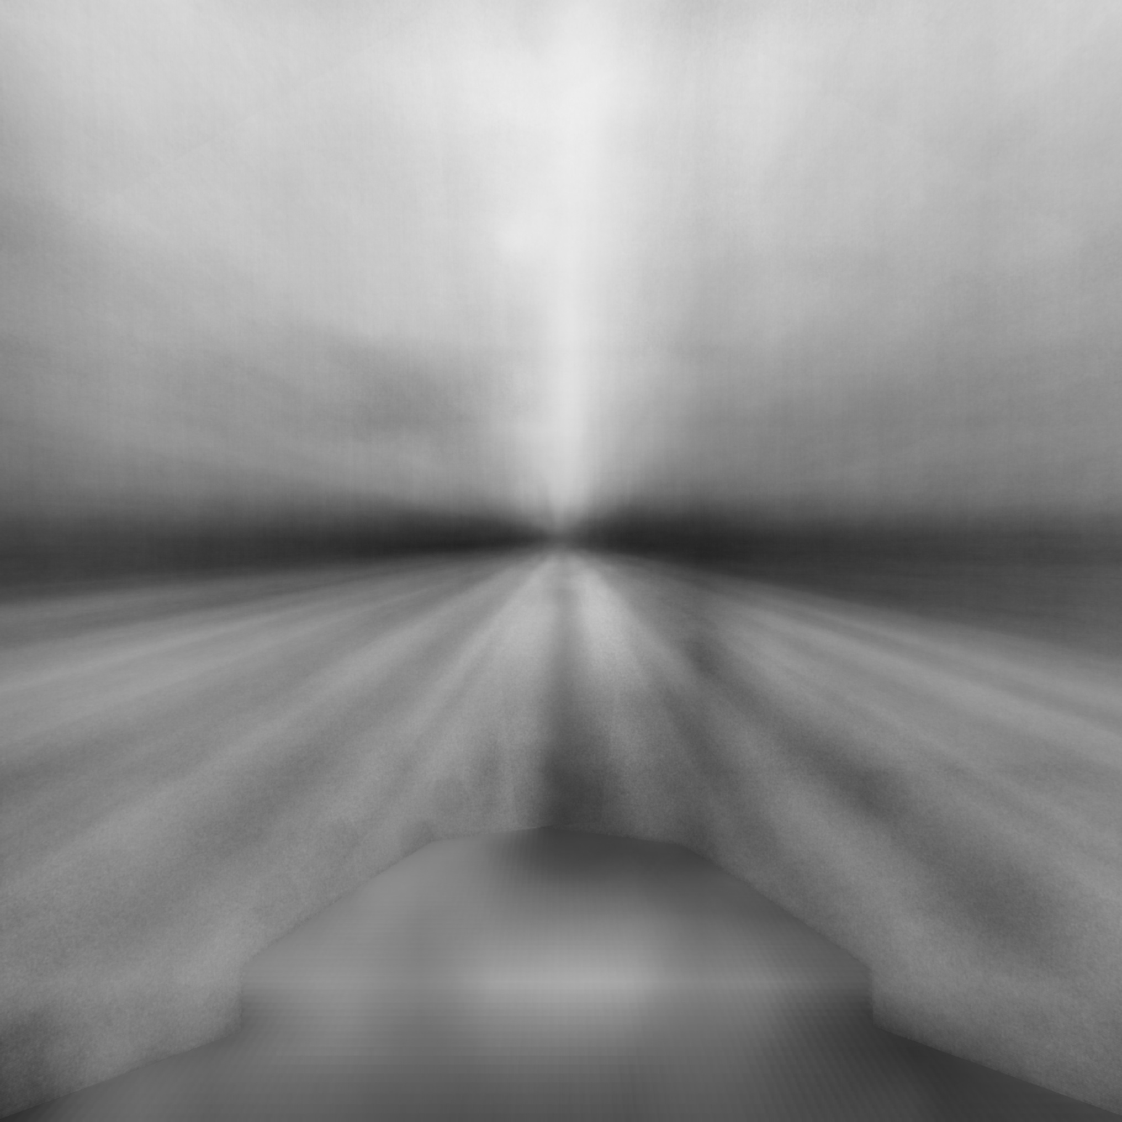

Ending Results - Camera 0
Mean Extracted
Mean Filtered Mask
Binary Mask

Slide 8
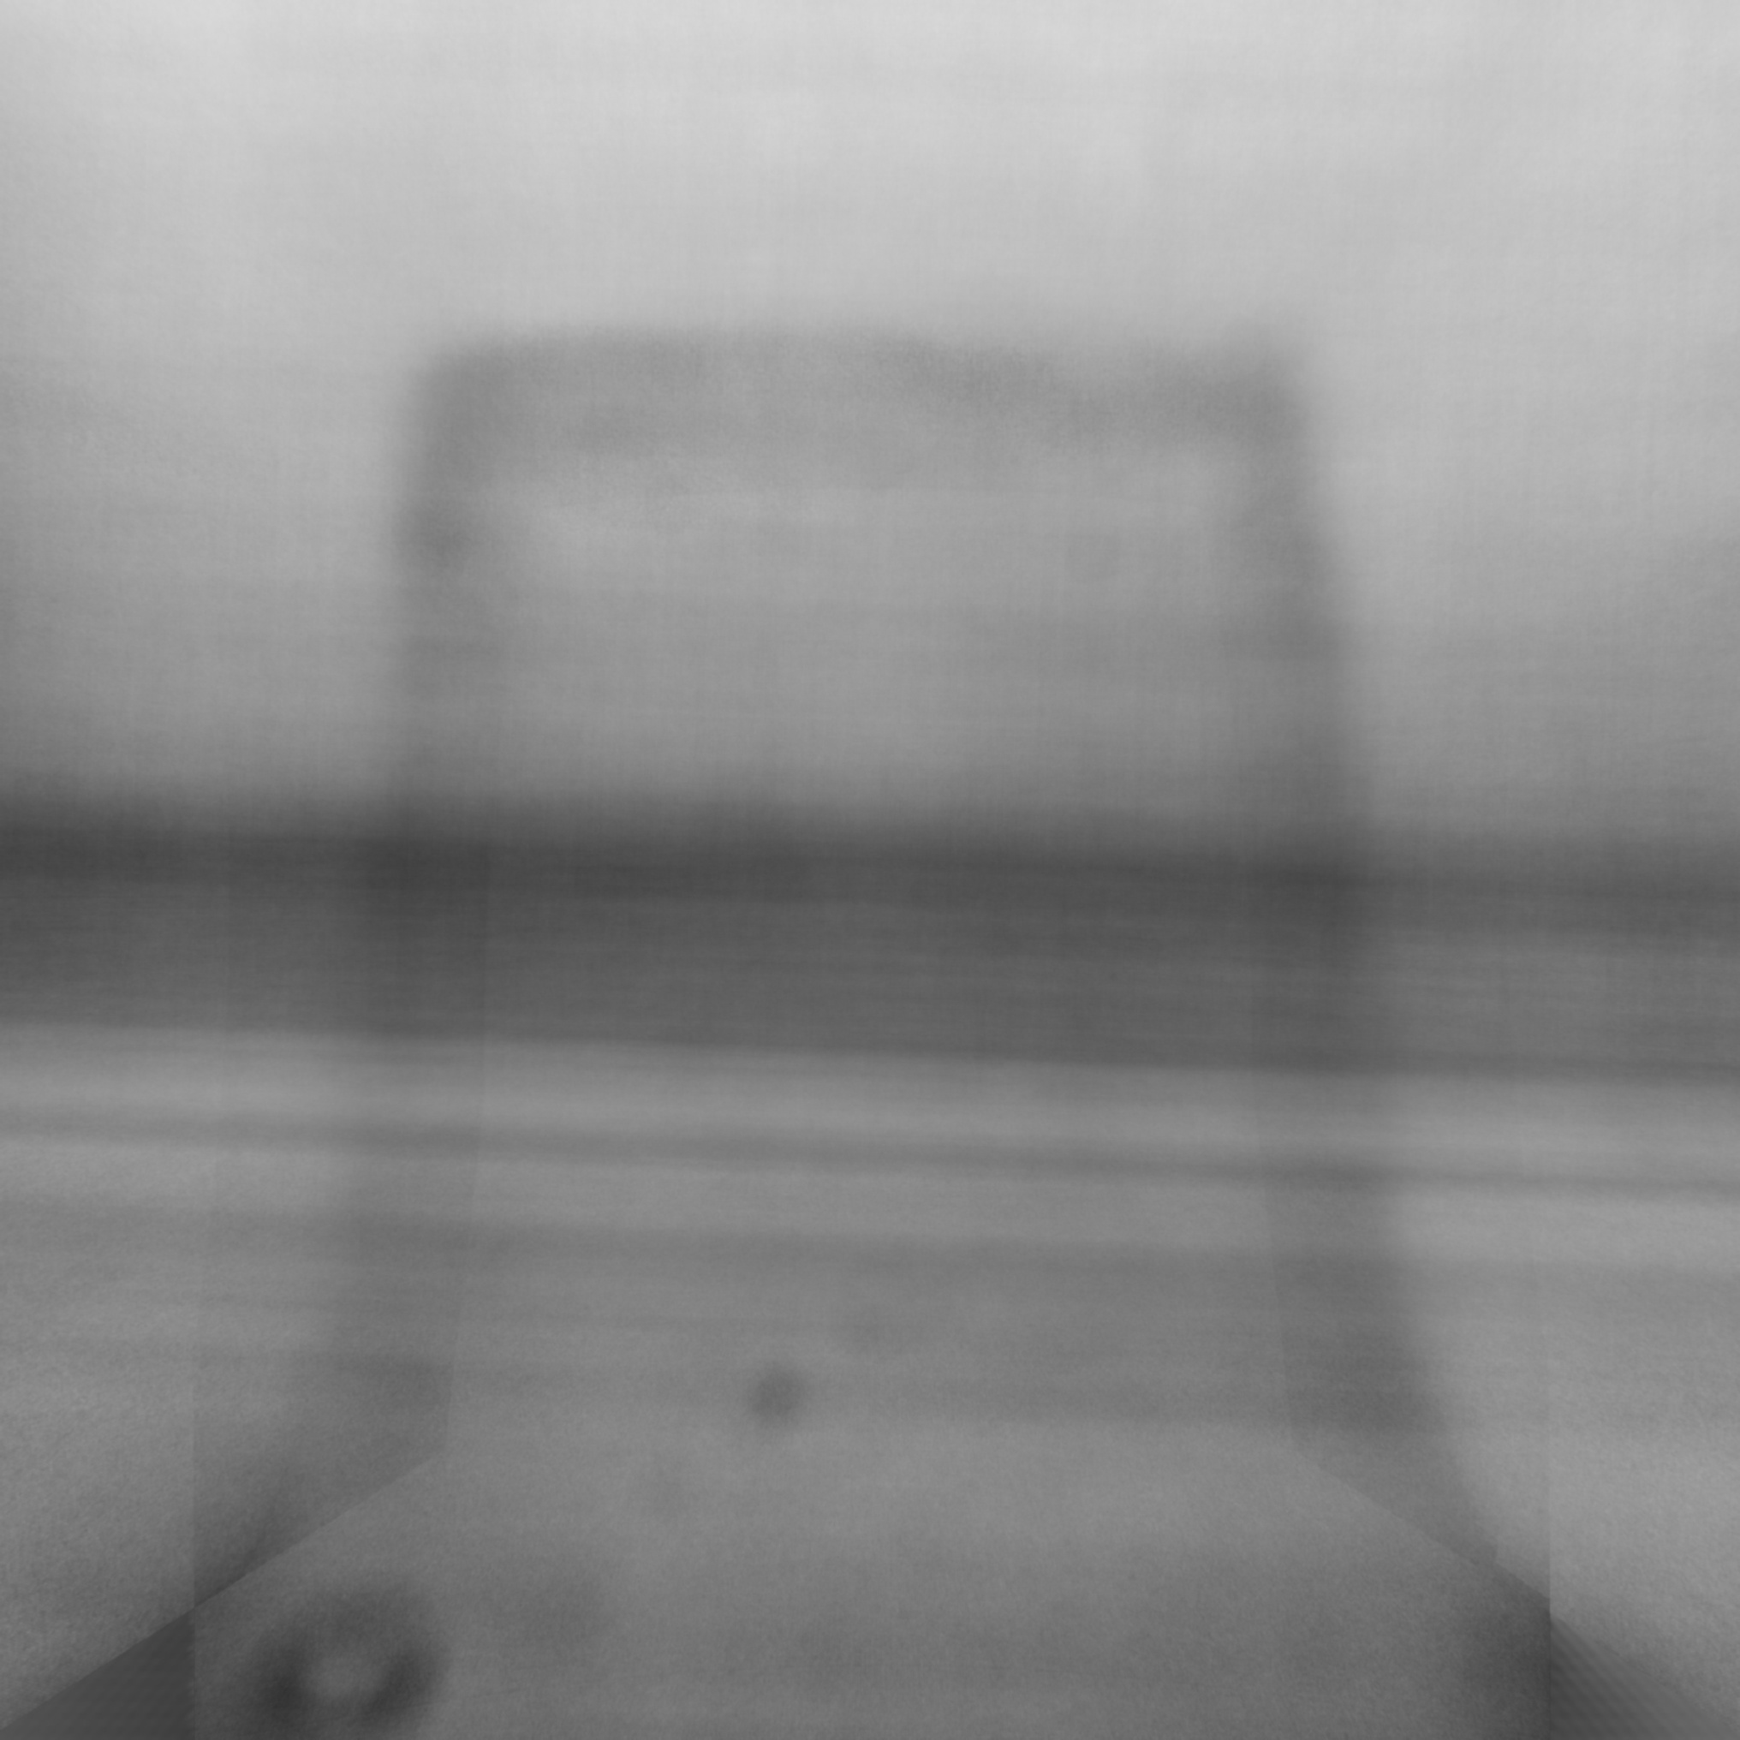
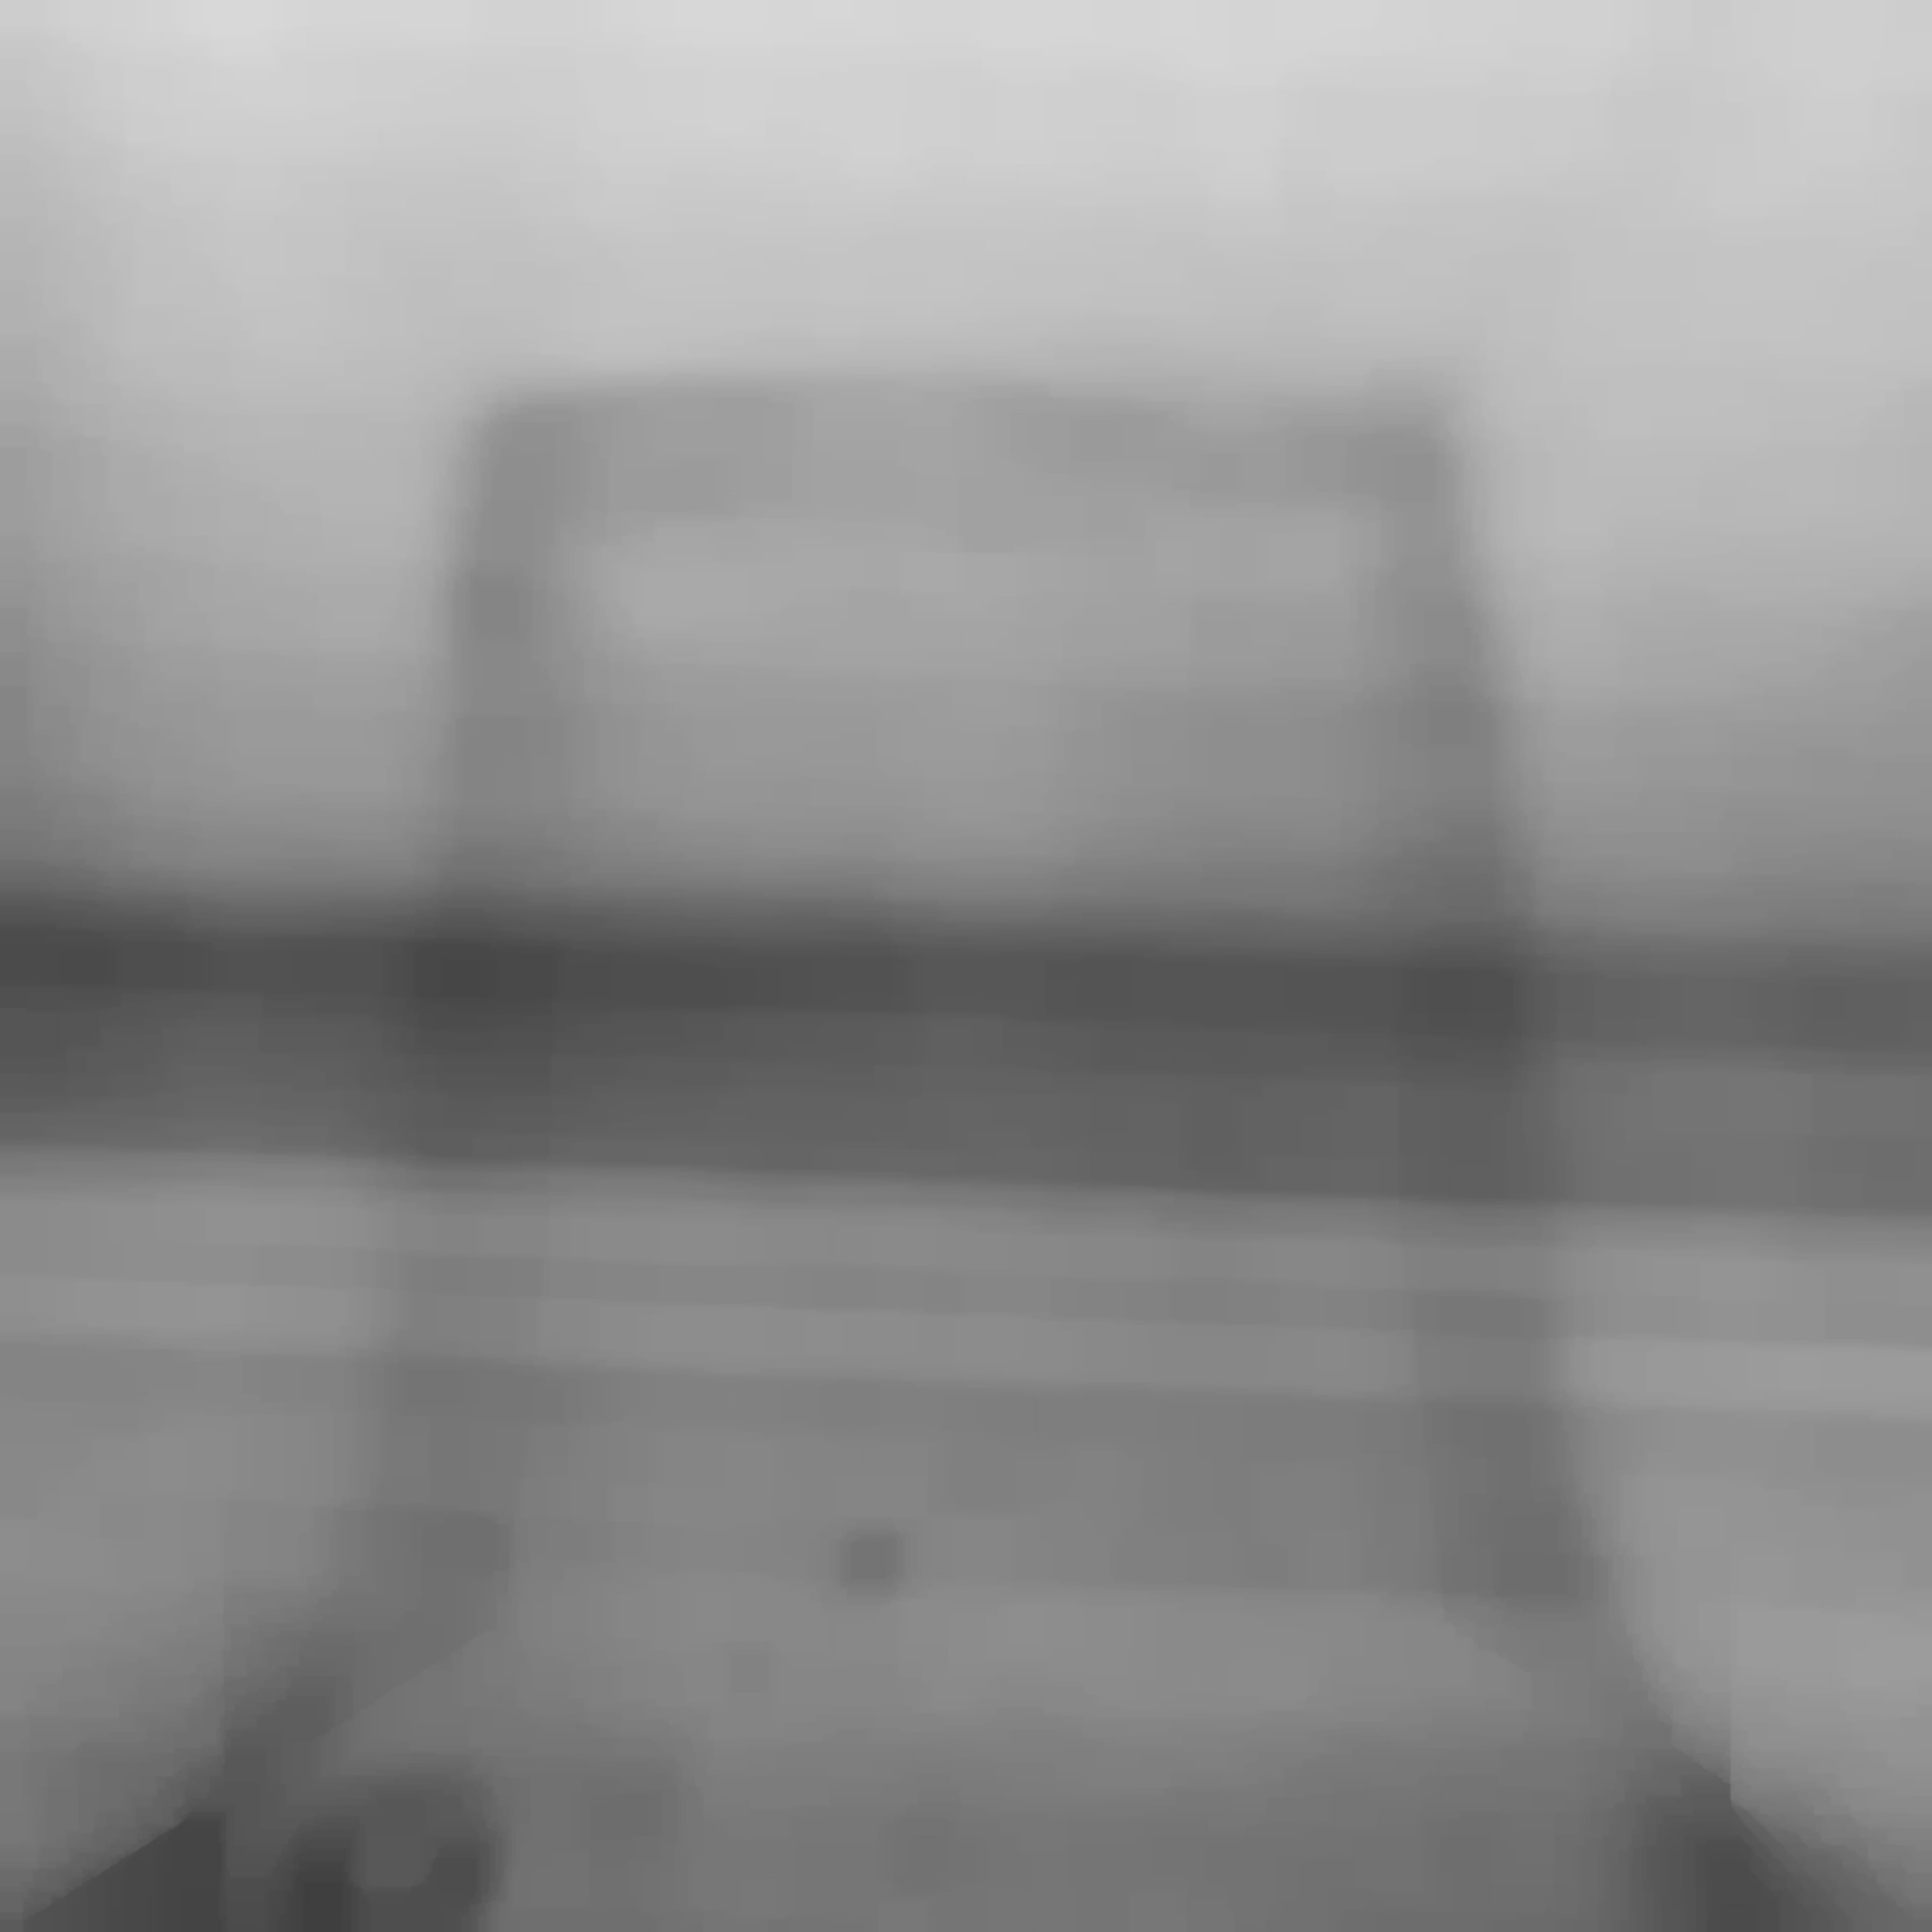

Ending Results - Camera 1
Mean Extracted
Mean Filtered Mask
Binary Mask

Slide 9
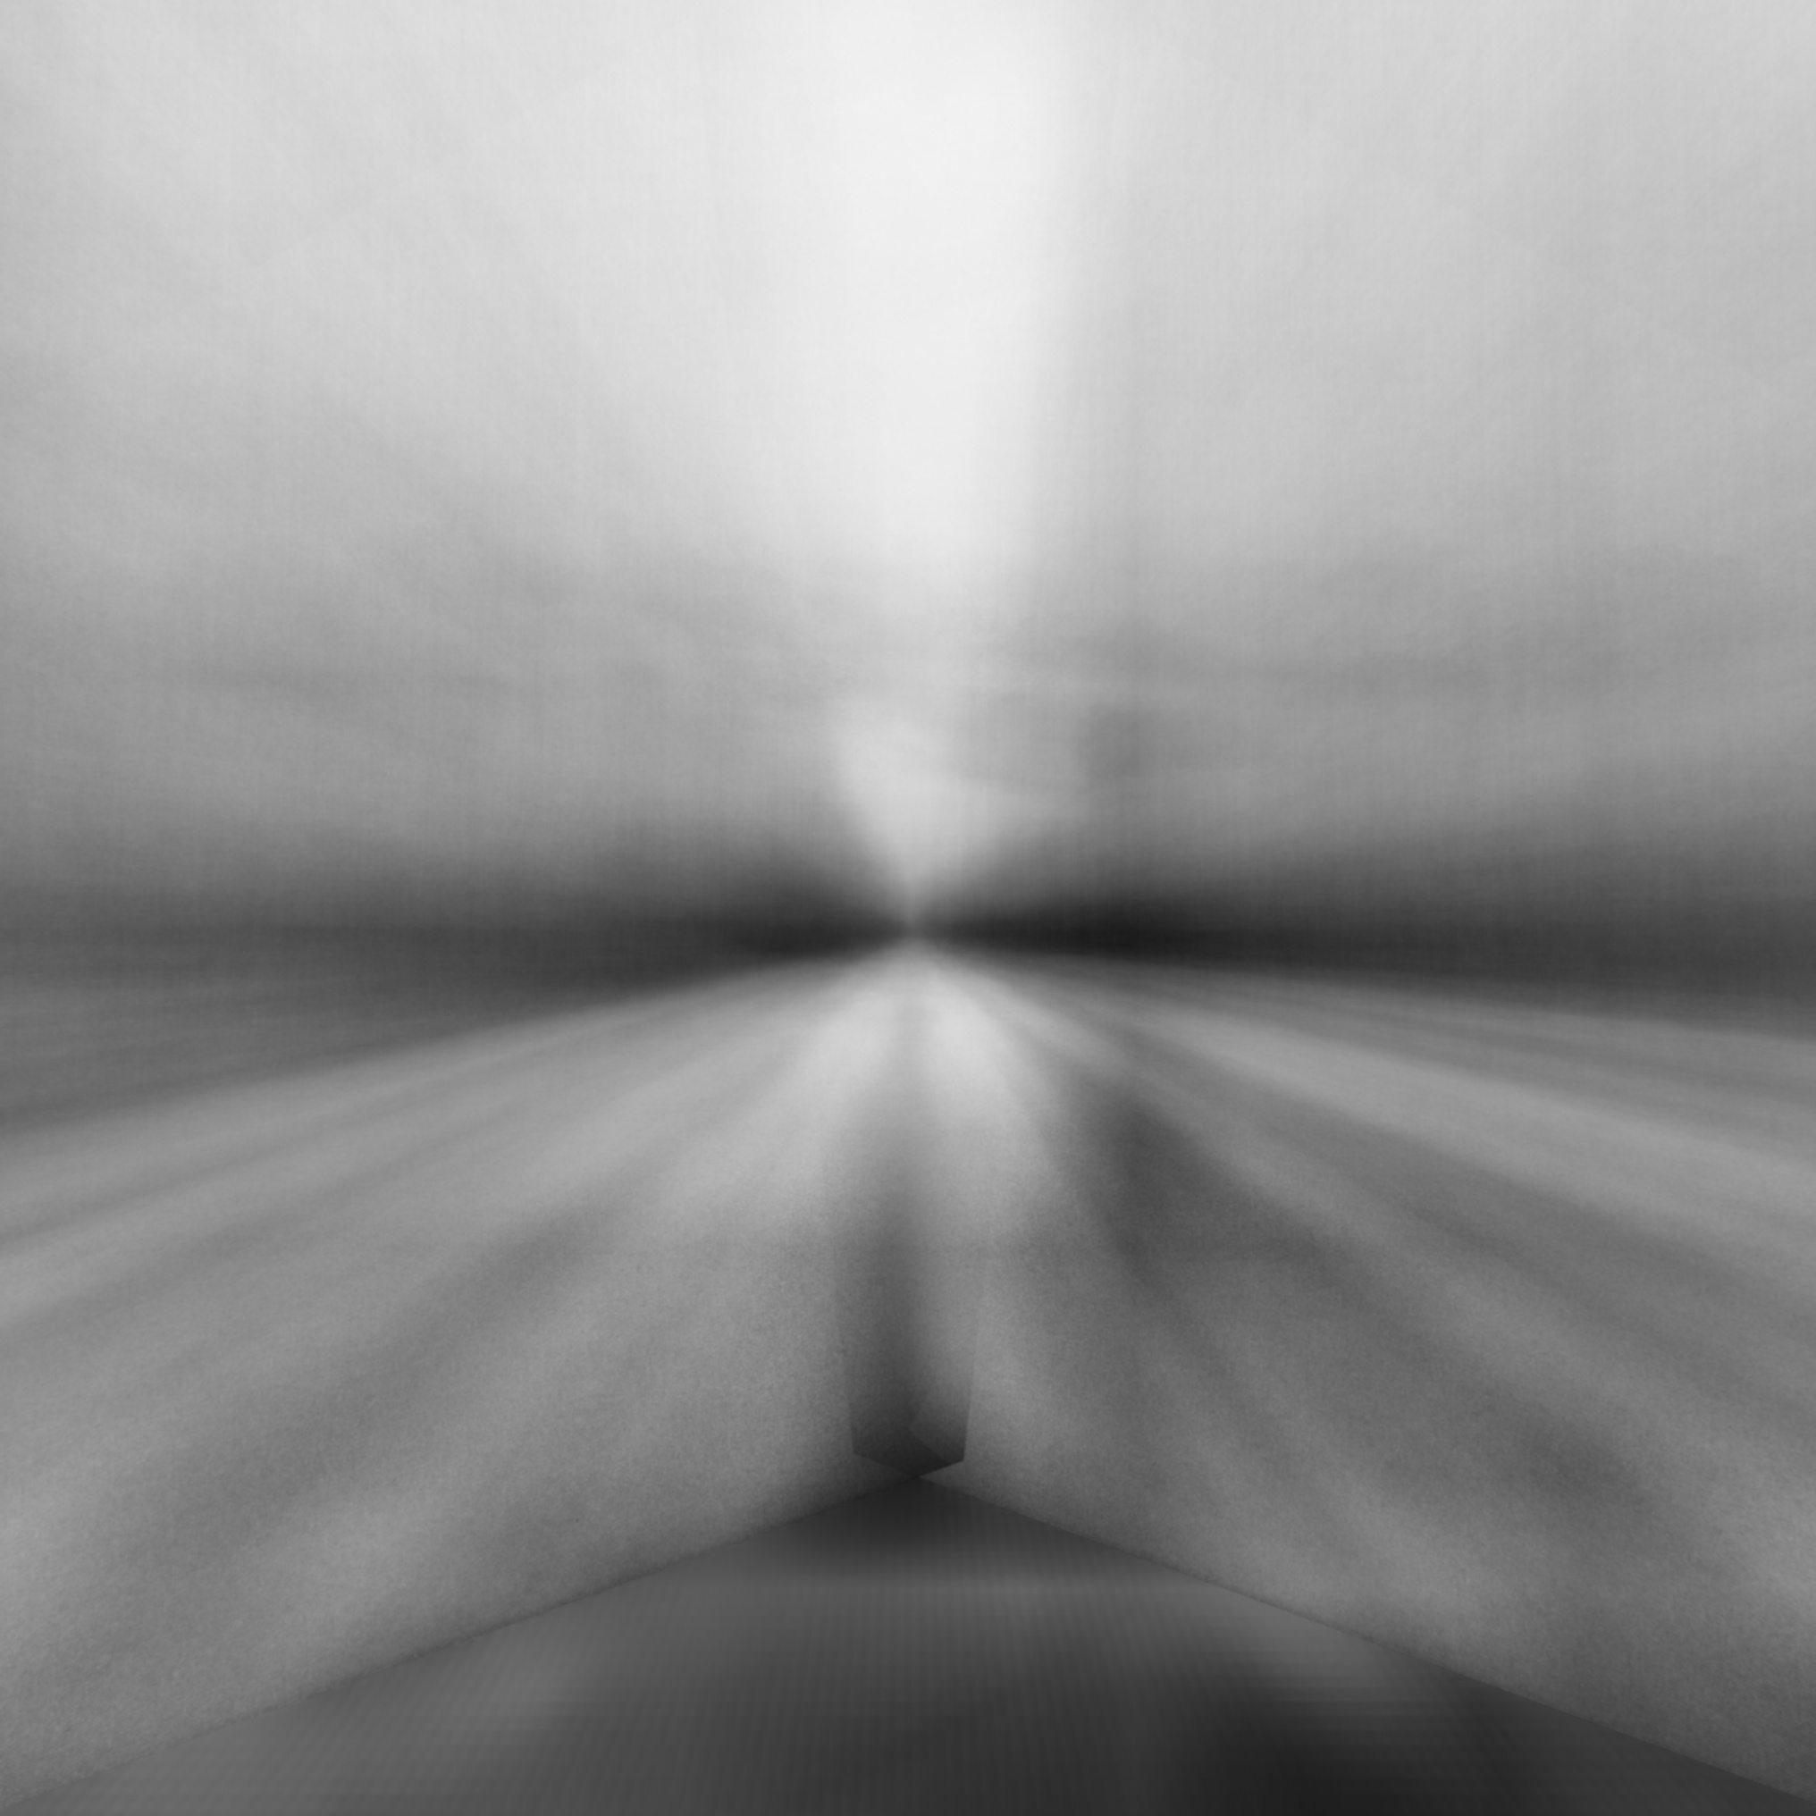
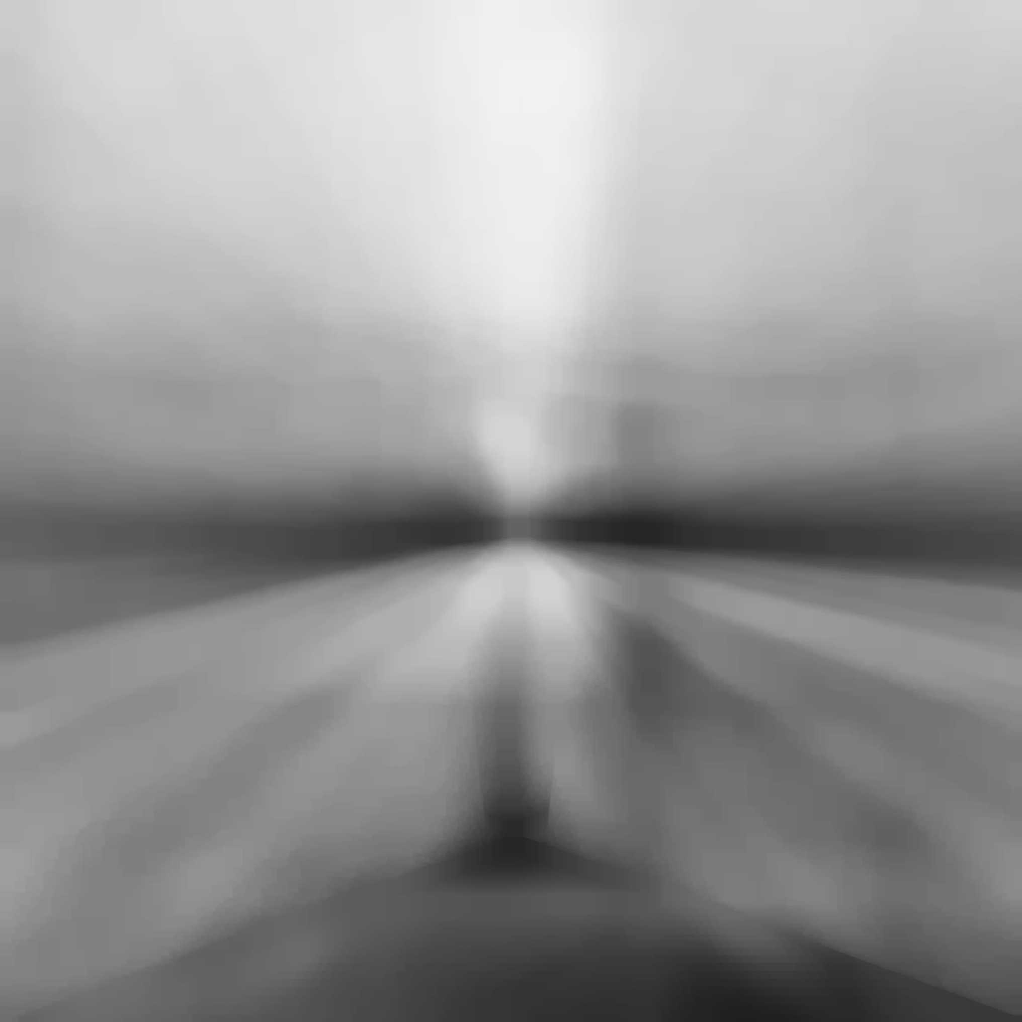

Ending Results - Camera 2
Mean Extracted
Mean Filtered Mask
Binary Mask

Slide 10
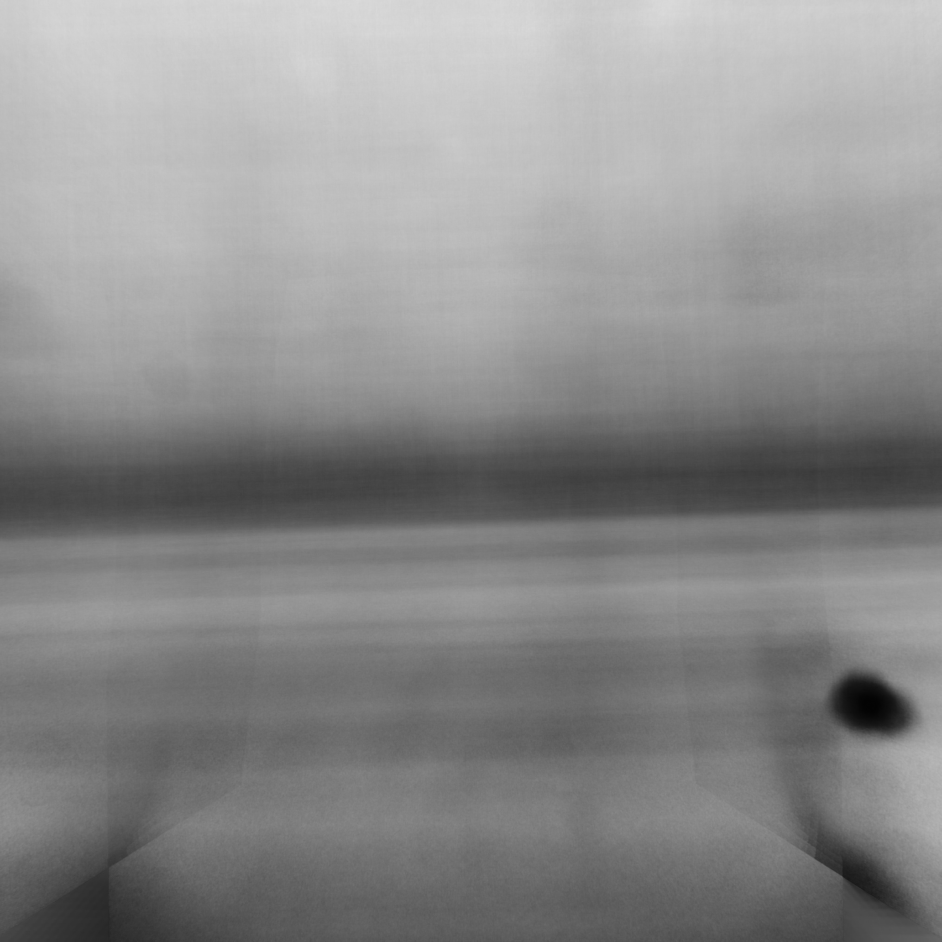
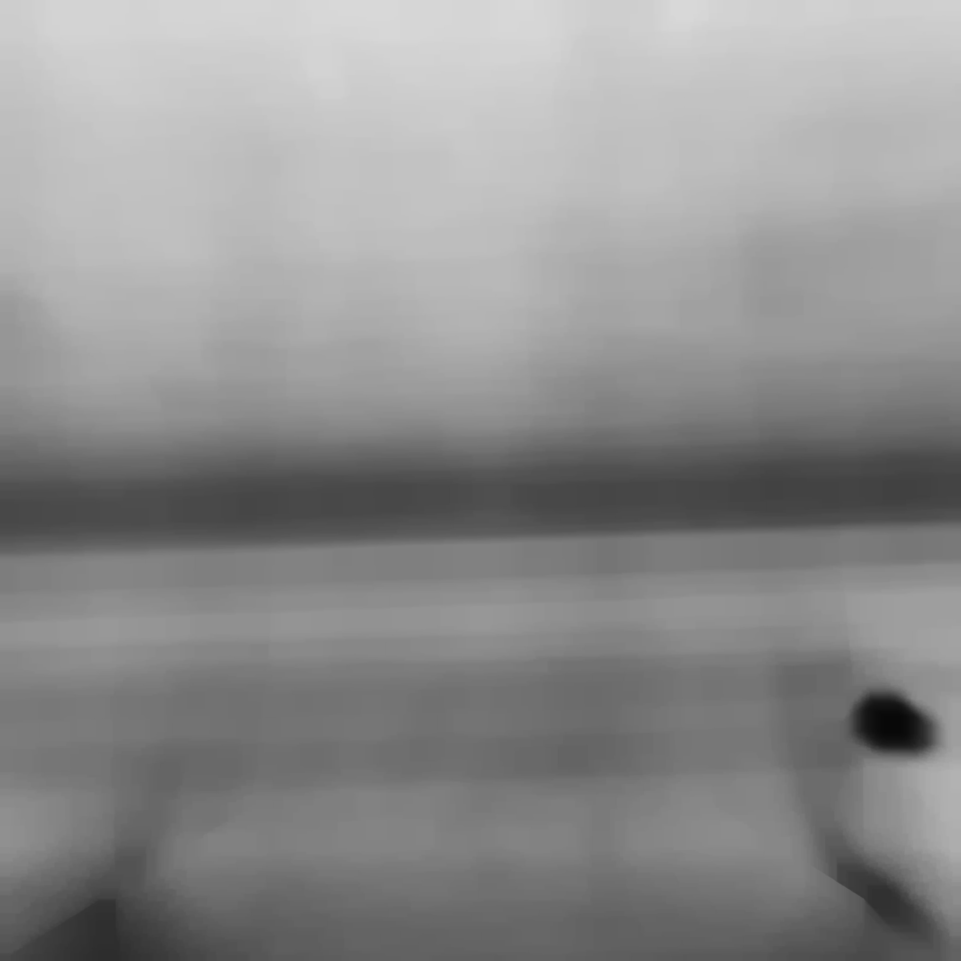

Ending Results - Camera 3
Mean Extracted
Mean Filtered Mask
Binary Mask

Slide 11

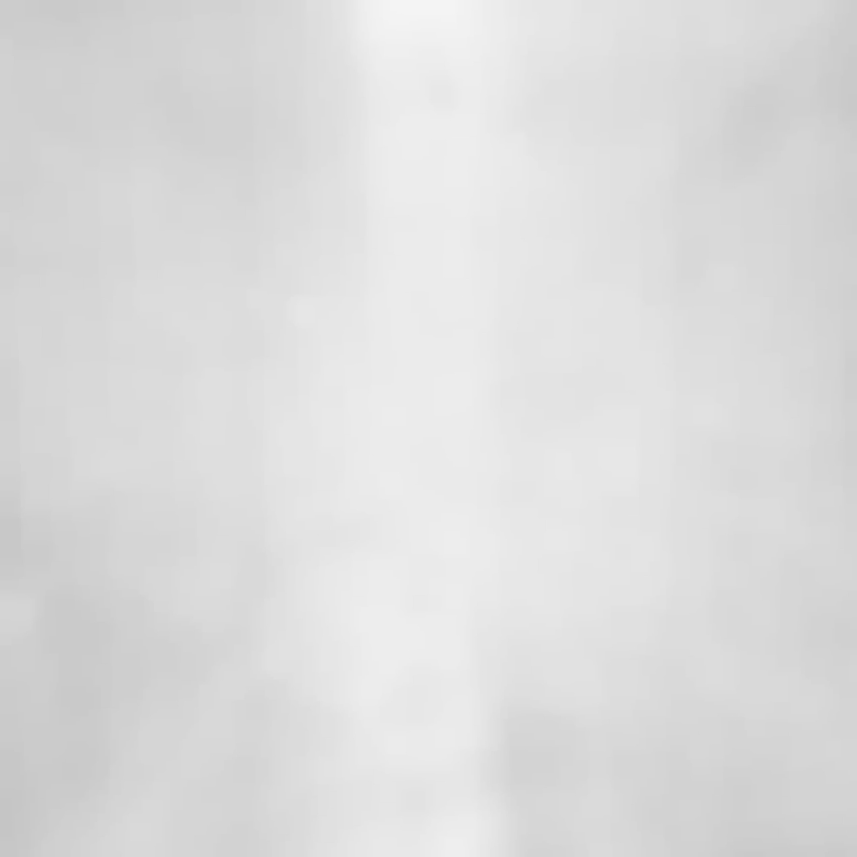

Ending Results - Camera 5
Mean Extracted
Mean Filtered Mask
Binary Mask

